Slide 1
Attachment Theory: New Developments
Contact:
Dr Sarah Foster, Department of Social Work,
Education & Community Wellbeing sarah.l.foster@northumbria.ac.uk

Slide 2
Background
Attachment has a longstanding place within social work theory and education
Though this place is debated (e.g. Shemmings vs White), and politicised (e.g. Narey)
This debate as about a strangely out-of-date account of attachment theory

Slide 3
Presentation today
To understand and respond to this situation we undertook some research
We asked social workers in two local authorities to tell us about their perspectives on attachment theory
And we asked attachment researchers what they think are the most relevant findings for social work
We would love to hear your thoughts!

Slide 4
Beginning a conversation
We would love to hear your thoughts! sarah.l.foster@northumbria.ac.uk
If you put a question or thought in the chat, together with your e-mail address, we will respond after the talk if we don’t get to it during the discussion
We have started writing about what we are discussing here. If you would be interested to see a copy – put your e-mail in the chat

Slide 5
Sarah’s research
Practitioners were generally thoughtful and careful in reflecting on attachment
Many social workers see attachment as important, but don’t feel confident in their knowledge
Practitioners were often relying on outdated ideas about attachment from before the 1980
Sometimes just based on the connotations of the words e.g. ‘attachment’ or ‘sensitivity’

Slide 6
Consultation with researchers
Researchers identified 8 ideas supported by contemporary attachment research, which they felt would be most relevant to social workers.

Slide 7
Safe haven

Slide 8
Security

Slide 9
Network of relationships

Slide 10
Stable, family-based care

Slide 11
Sensitivity

Slide 12
Mentalising

Slide 13
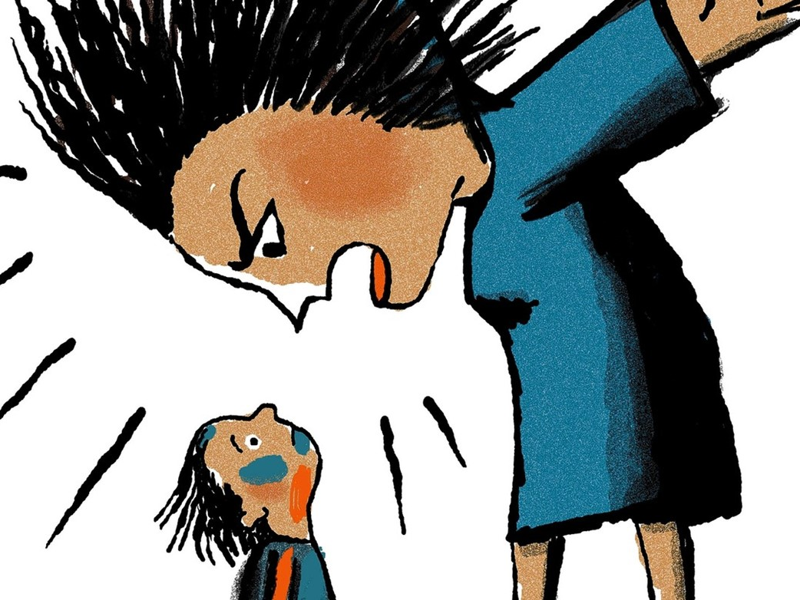
Alarming behaviour

Slide 14
Poverty and adversity

Slide 15
Conclusions
Lots of change in attachment theory in recent decades
Time to move on from focus on mother-infant bonding and categories of insecurity?
Keen to begin a conversation – do get in touch

Slide 16
Attachment Theory: New Developments
Contact:
Dr Sarah Foster, Department of Social Work,
Education & Community Wellbeing sarah.l.foster@northumbria.ac.uk

